Slide 1


Application for University Accommodation Office
CS4354 Concepts of Database Systems
Randall Harper
12/1/15

Slide 2
Application Development Tools
  Software
    phpMyAdmin
    PHP/HTML
    Wamp
    Sublime
  Any OS

Slide 3
Application Techniques
PDO - PHP Data Object
  PDO constructor - creates PDO instance representing a connection to the database.
  “Echo” used to define names of columns and our table design
  Try
    “Try” separate connections to the database for each query
    Each query is defined and executed, fetched from the database
  Catch
    If query fails, “catch” will display error message

Slide 4
Selected Queries
Query #4: Display the details of the total rent paid by a given student.
Query #8: Present a report listing the details of all students currently on the waiting list for accommodation; that is, who were not placed.
Query #9: Display the total number of students in each category.
Query #11: Display the name and internal phone number of the Advisor for a particular student.
Query #13: Display the total number of places in each residence hall.

Slide 5
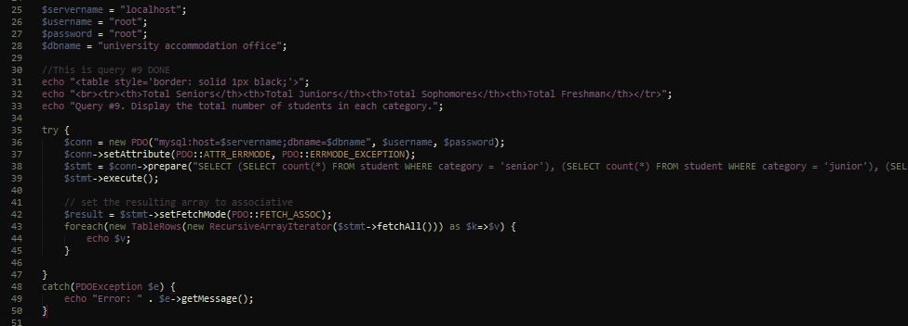

Example – Query #9
PHP Code:
Resulting Table:
Notes:
Nested select function to count each column

Slide 6
Demo

Slide 7
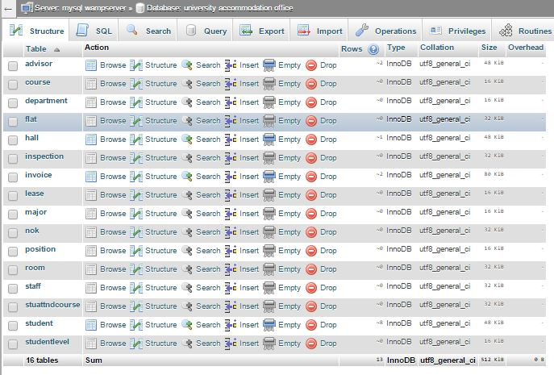
UAO Database

Slide 8
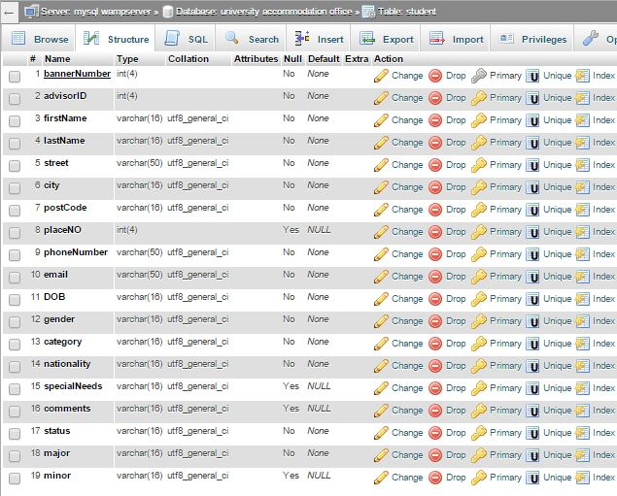
UAO Database – Student table

Slide 9


